Slide 1
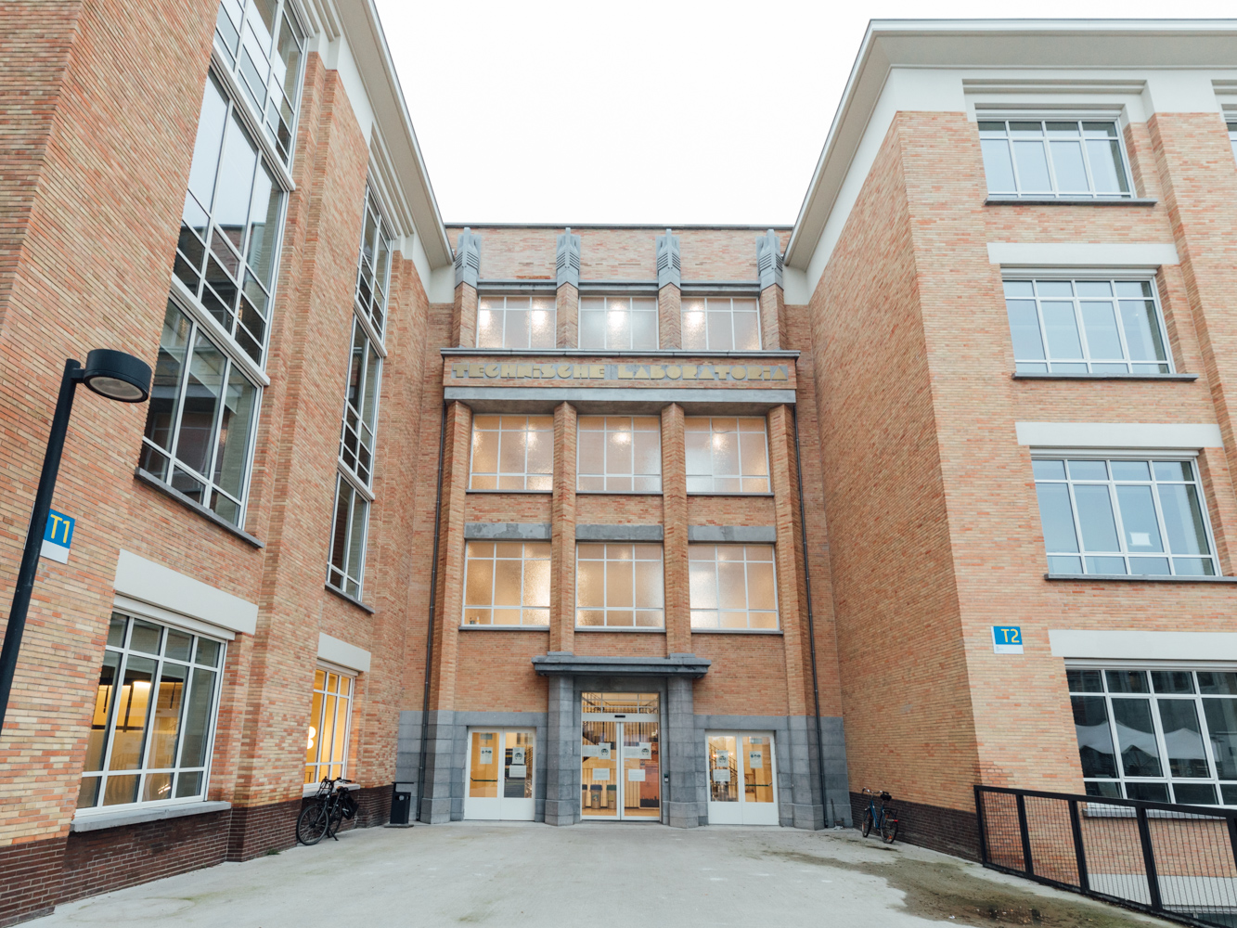
Welcome to the library of the faculty of Political and Social Sciences!
Turn right upon entering the building.

Slide 2

Regular opening hours:
Monday to Friday
from 9 am until 5 pm.

Slide 3
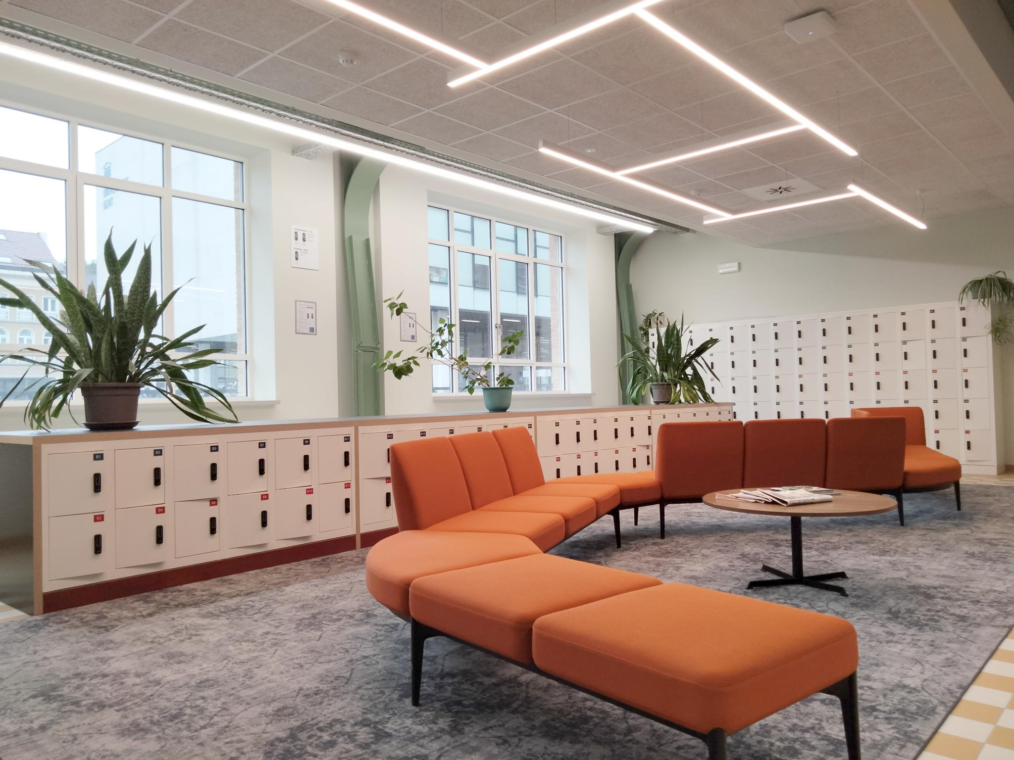
For safety reasons (theft), we strongly advise to put bags and backpacks in the lockers near the entrance.
Tip: take a picture of your locker.

Slide 4
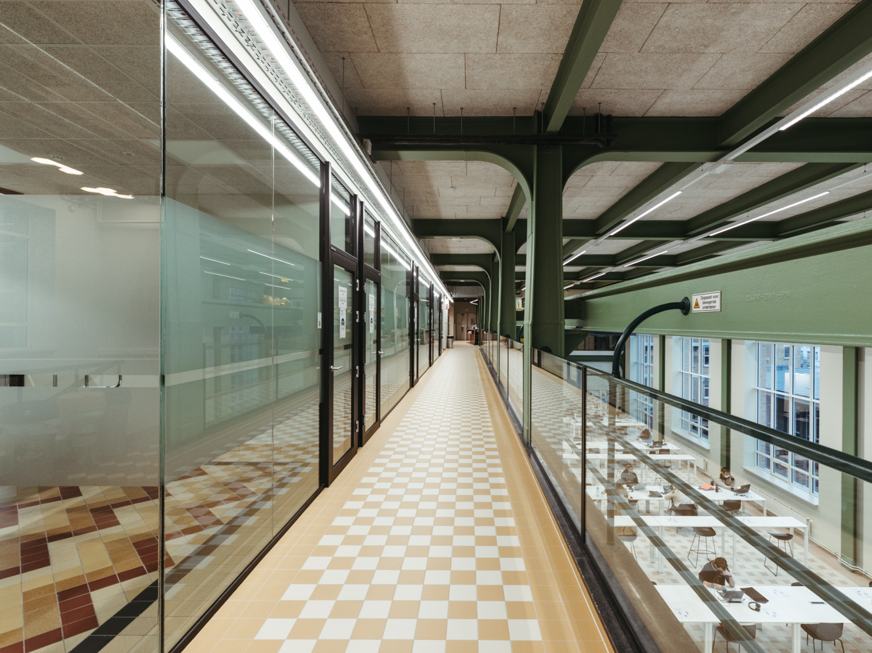
We have two floors in our library
- On the ground floor you can find the desk, our meeting rooms and some study places;
- At -1 you can find our books, journals and our reading room. Also, the rest room is at -1;
- There is a staircase as well as an elevator in our library.

Slide 5
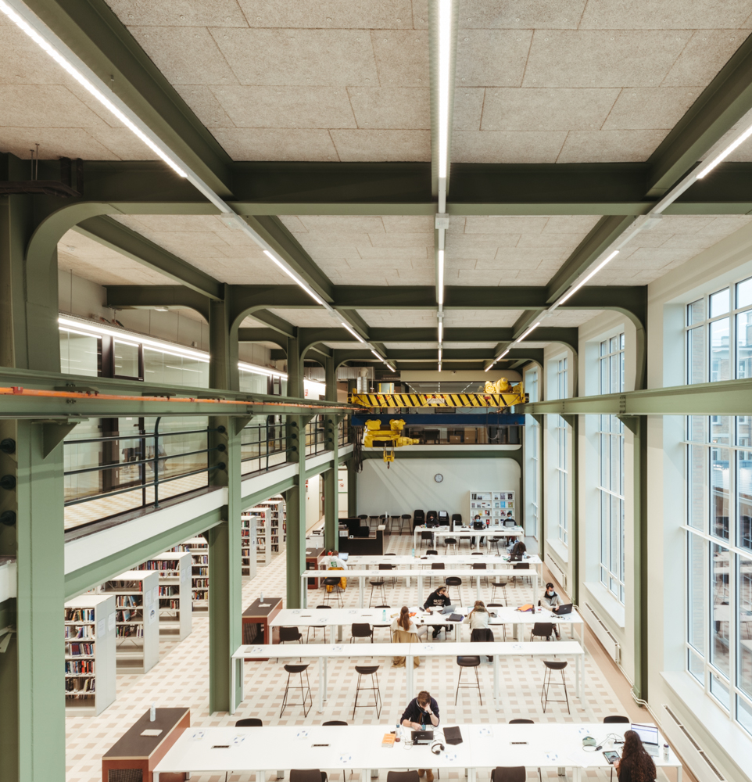
Reading room
- Our reading room clearly shows the original structure of the interbellum building.
- It has a capacity of 120 study places.

Slide 6
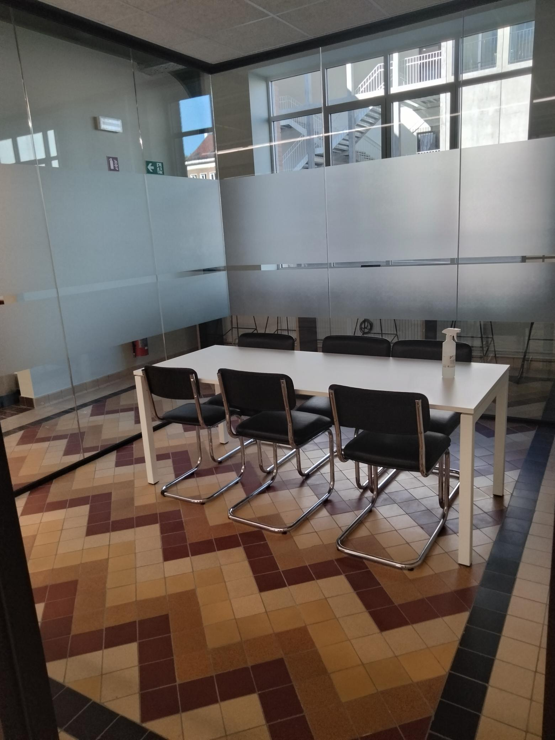
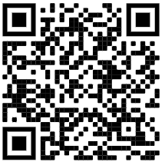
Reserve a meeting room
2 meeting rooms with a capacity of 16 persons:
Room August Van den Brande & Room Fatima Mernissi.
3 meeting rooms with a capacity of 8 persons:
Room Frieda Saeys, Room Marthe Versichelen & Room Denis McQuail.
2 meeting rooms with a capacity of 6 persons:
Room Els De Bens & Room Gerard Mortier.

Slide 7
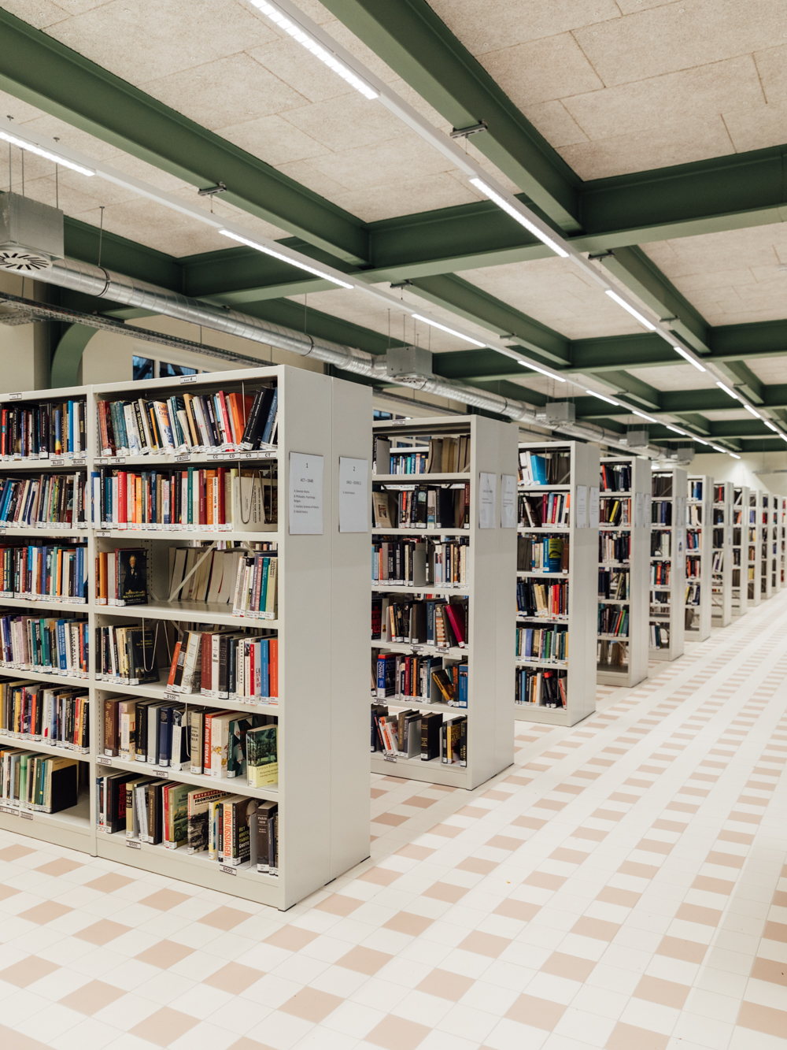
Print collection
About 15.000 books
Downstairs next to the reading room
Organized in relevant topics
Browse the shelves or surf to the UGent catalogue: lib.ugent.be

Slide 8
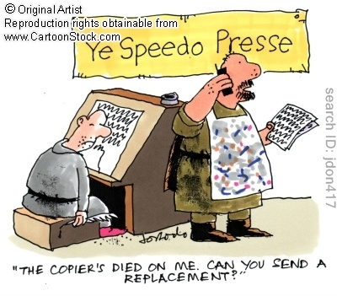
Printing and scanning
- The scanning and printing machines are downstairs in the library
- Scanning is free of charge. Log in with your student card
- Printing is possible via e-purse
- All info can and instructions be found at helpdesk.ugent.be/en/

